Slide 1
Examining sushi restaurants in NY
Coursera – Final Capstone

Slide 2
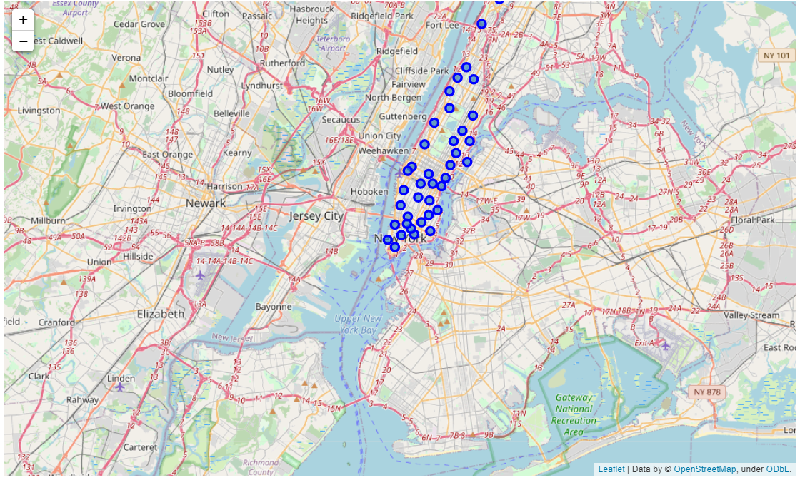
Introduction
As a Sushi Enthusiast i wanted to review how Sushi Restaurants in NY Manhattan perform against other Restaurants
We examined which area is the GO-TO Spot in NY with helps of Foursquare
These informations can be useful for tourists, sushi lovers and sushi investors
We also reviewed all other kinds of restaurants in an area and compared them by quantity
Manhattan Map with Neighborhood marks

Slide 3
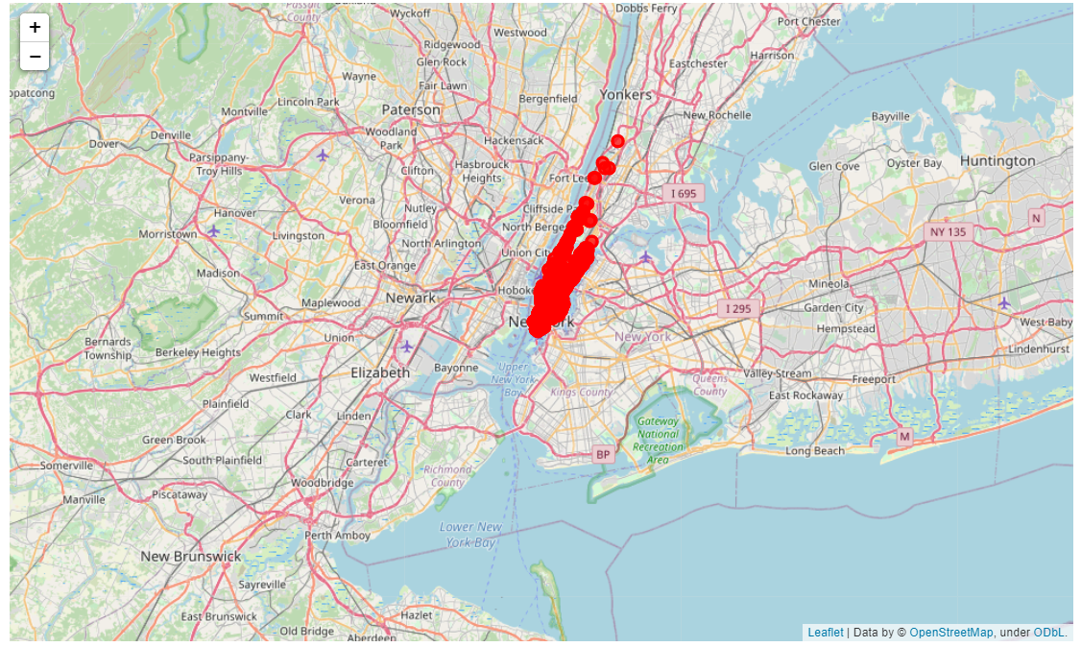
Visualization
We see that you will not face any issues finding a Sushi Restaurant in New York
But, in which Neighborhood do we have the highest number of Sushi

Slide 4
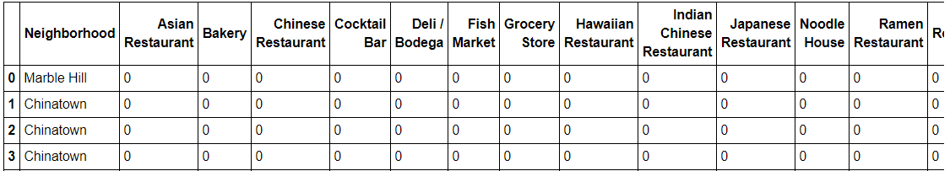
Detail Analysis
Therefore, we analyse in detail, which kind of Restaurants can be found in which area
For the full table see the shared Notebook, please

Slide 5
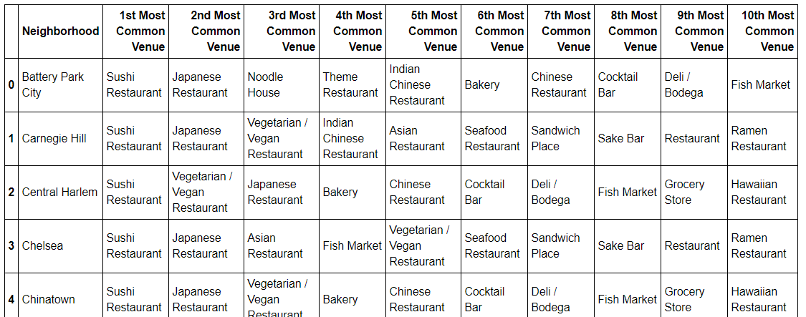
Detail Analysis
Furthermore, we group which venues are the most common each neighborhood
This will give us a slight indicator, that Sushi mostly dominates in NY.

Slide 6
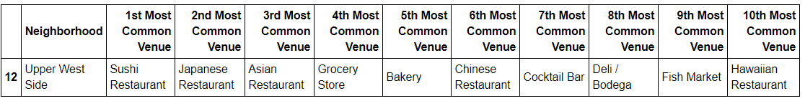
Detail Analysis
As we proceed we see that mostly Asian Restaurants dominate the Upper West Side mostly
So for Asian Food Enthuasiasts like myself definetly the right adress to go.

Slide 7
Conclusion and Future Research
Well these information can be used for tourists, whether to go on their sight seeing, which restaurants based on which values to visit etc.
Furthermore, it gives a slightly insight about business opportunities.
It seems that asian food is quite successful in Manhattan, because it is booming
But if it is a good business opportunity or not cannot be assessed with this kind of data, because you would need more in detail knowledge on which people live there, which kinds of customers does the restaurants have and so on
This will be definitely my future research after completing the course, just for fun ;)
Thanks for your time and review my friend. Best greetz.

